Slide 1

BCA - Final Year Project (End-term) Session:
2024-2025

Slide 2
PG admission prediction based on demographic data
Supervisor (s): Dr. Asha Sohal
Team Member(s):
Anvi(22bca129)
Bhoomi(22bca130)
Meetanshi(22bca089)
Bachelors of Computer Application

Slide 3
Description Of The Topic
Growing demand for data-driven tools to predict admission trends and job availability in engineering & technology fields.
Importance of demographic factors (location, socioeconomic status, state-wise education policies) in shaping career opportunities.
Application of Machine Learning (ML) to analyze historical data and forecast future admission and employment patterns.
Helps students, educators, and policymakers make informed decisions.

Slide 4
Feasibility Study
Technical Feasibility:
Use of established ML algorithms (Gradient Boosting, Random Forest) with proven accuracy on admission/job datasets.
Frontend built with React ensures responsive and maintainable UI.
Backend integration with Flask supports scalable API services.
Economic Feasibility:
Utilizes open-source software and free public datasets to reduce costs.
Development handled by team members minimizing external expenditure.
No additional hardware requirements beyond standard computers.
Operational Feasibility:
Web application accessible via browser, compatible with mobile and desktop devices.
Designed for ease of use with multi-step form and dark mode option.
Potential for future scalability with modular codebase and cloud deployment.

Slide 5
Existing Solutions/Literature Review
Most existing tools focus only on admission prediction or only on job forecasting, but do not combine both. Example: College admission prediction sites focus just on chances of getting into colleges. (Source: JetIR research paper on ML admission prediction)
Many systems use basic statistics instead of advanced machine learning, which limits accuracy. Example: Some government reports show job trends but don’t use ML models for forecasting. (Source: Academia study comparing ML techniques for admission prediction)
Most research ignores demographic details like location or socioeconomic status or uses them lightly, reducing prediction relevance. Example: Studies on medical school admissions show demographic factors like low-income status impact results but are often overlooked. (Source: BMC Medical Education study on demographics and admissions)
Few platforms offer personalized recommendations like scholarships or career guidance along with predictions. Example: Some career guidance systems predict jobs based on skills but don’t include scholarships or certificates suggestions. (Source: IJCRT paper on ML-based job role prediction)

Slide 6
GAPS in existing solution/literature review
Lack of multi-algorithm model comparison to select best predictive performance.
Minimal focus on real-time, interactive UI for end-users to engage with predictions dynamically.
Limited integration of demographic location data affecting prediction accuracy.
Absence of supporting features like scholarship or career guidance alongside core predictions.

Slide 7
Problem Statement
Challenge: Difficulty for students and educational planners to forecast admission chances and job prospects accurately with respect to geographic and demographic variations.
Objective: Develop an integrated system that predicts admission and job outcomes using multiple ML models, incorporating demographic inputs to enhance prediction relevance.

Slide 8
Objectives
Design and implement multiple machine learning models (Linear Regression, Random Forest, Gradient Boosting) for predictive analysis.
Integrate demographic data (state-wise, region-specific) to contextualize predictions.
Develop an intuitive, multi-step frontend interface for personalized user data collection.
Evaluate model performance using standard metrics (RMSE, R², accuracy).
Provide actionable insights and recommendations through a user-friendly dashboard.

Slide 9
Tools/platform Used
Frontend: ReactJS with component-based architecture for modular, maintainable UI.
Backend: Flask framework serving as API for ML model predictions.
ML Libraries:
scikit-learn (for Linear Regression, Random Forest, Gradient Boosting)
pandas and numpy (data manipulation and preprocessing)
Data Visualization: matplotlib, seaborn for exploratory data analysis.
Database/Storage: Firebase or JSON files for storing user inputs and results.

Slide 10
Design Methodology
Frontend Design Approach:
Component-Based Architecture: Built using reusable React components like App.js, PersonalInfo.js, etc.
Step-wise Navigation Logic: Navigation between form steps managed via useState(step) for better flow control.
Data Flow with Props: Form data passed and handled between components using props (e.g., onNext(info)).
User Experience (UX) Focused:
Progressive, multi-step forms for a clean and guided user journey
Form fields include: Name, Phone, Email, and State (dropdown)
Labels are left-aligned with color-coded validation for required fields
Responsive and Themed UI:
CSS used to create a responsive layout (split fields for first & last name)
Includes dark mode toggle for better accessibility
Semi-transparent overlay with background image ensures readability

Slide 11
Challenges and Issues identified
Acquiring clean, consistent datasets incorporating demographic and employment data.
Handling data imbalance and missing values during preprocessing.
Achieving low prediction error while maintaining model generalization.
Integrating frontend inputs accurately with backend prediction APIs.
Ensuring UI responsiveness and user-friendly error handling.

Slide 12
Methodology &Implementation/ Interface and Design Implementation
Frontend:
Multi-field personal information form capturing name, phone, email, and state (dropdown).
Field validation with required indicators and left-aligned labels for clarity.
Progressive disclosure of form steps to avoid user overwhelm.
Feature highlights post-form submission (e.g., 1-on-1 support, scholarship guidance).
Dark mode toggle implemented for accessibility.
Backend:
Implements multiple ML models to predict admission and job likelihood.
Uses best performing Gradient Boosting model for final prediction based on RMSE and R² scores.
REST API receives user data and returns prediction outcomes.

Slide 13
Testing and Performance Evaluation
Model | RMSE | R² Score | Accuracy
Linear Regression | 59.09 | 0.8605 | 98.20%
Random Forest Regressor | 35.16 | 0.9506 | 98.66%
Gradient Boosting Regressor | 30.14 | 0.9637 | 99.03% (Best)
Models evaluated on test data using cross-validation.
Performance metrics chosen to balance error minimization and model fit quality.
Frontend usability tested for various screen sizes and user input cases.

Slide 14
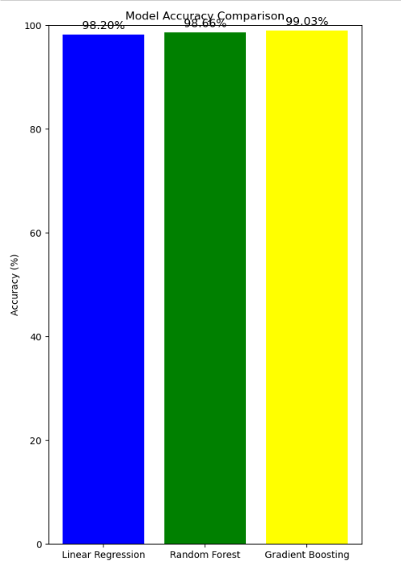
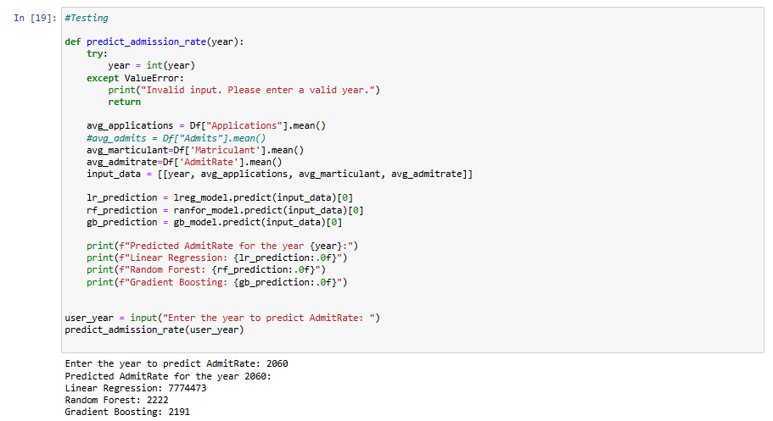

Slide 15
Outcome
Developed a reliable prediction system with high accuracy (>99%) using Gradient Boosting.
Interactive web interface enabling personalized input and instant prediction feedback.
Incorporation of demographic location significantly improved prediction relevance.
Provides practical recommendations including scholarship and certificate guidance.
Platform capable of aiding students and administrators in decision making.

Slide 16
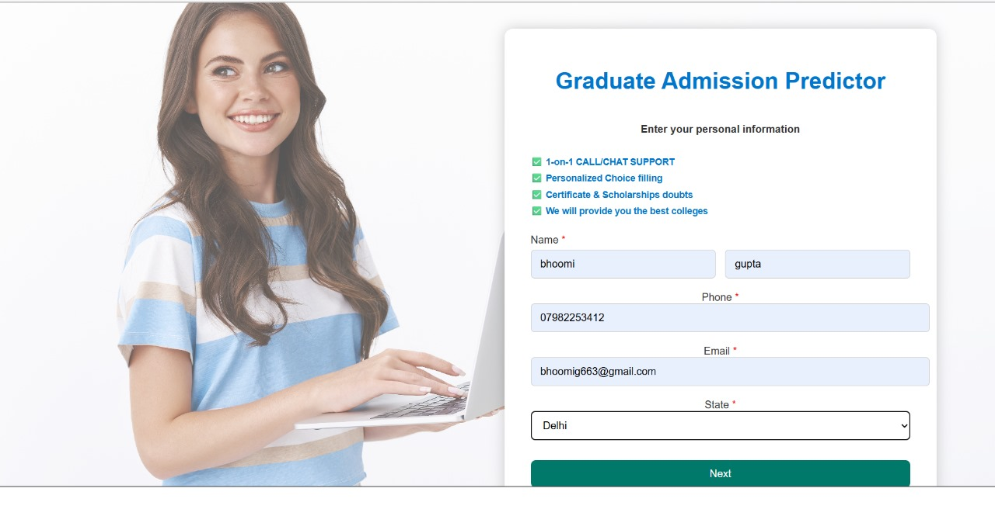
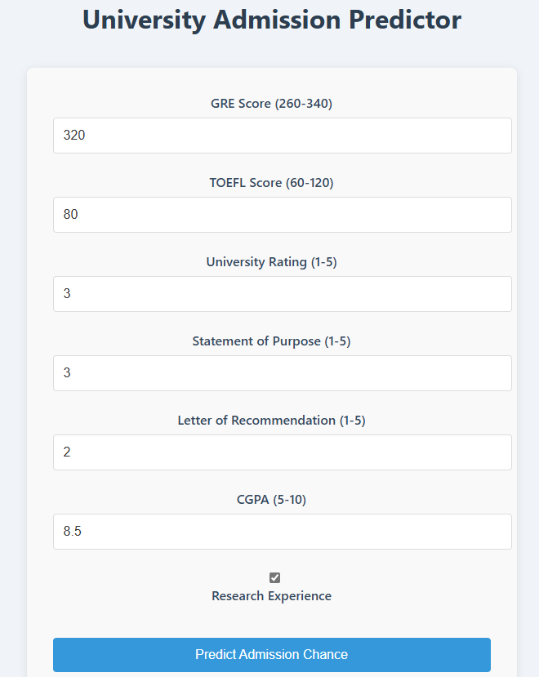
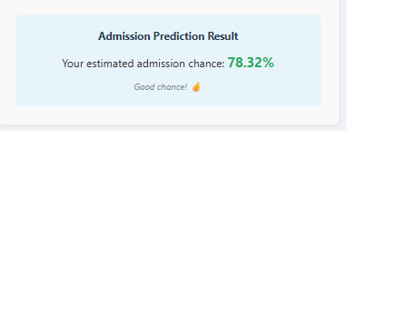

Slide 17
GANTT Chart
Task / Phase | March 2025 | April 2025 | May 2025
Project Topic Finalization | █
Feasibility Study & Requirement Analysis |  | ███
Literature Review & Problem Study |  | ████
Dataset Collection & Preprocessing |  | ███
ML Model Development (All 3 Models) |  | ████
Frontend UI Design (React) |  | ███ | █
Backend API Integration (Flask) |  | ██ | ███
System Testing & Evaluation |  | ██ | ████
Final UI Polishing |  | █ | ███
Report Writing & Documentation |  | █ | █████
PPT Preparation |  |  | ████
Final Review & Submission |  |  | ████

Slide 18
Responsibility Chart
Team Member | Responsibility
Anvi | ML model implementation and backend API
Bhoomi | Frontend design, UI/UX, and responsiveness testing
Meetanshi | Data gathering, preprocessing, documentation

Slide 19
Broader Impact factor Status
Social Impact:
Facilitates informed career decisions for students across diverse regions.
Enhances access to education and job insights for underrepresented demographics.
Economic Impact:
Assists educational institutions in resource planning and admission management.
Supports workforce development by aligning educational outputs with job market demand.
Technological Impact:
Demonstrates effective ML deployment in education-tech domain.
Encourages integration of demographic analytics in predictive modeling.

Slide 20
References
JetIR Paper on Admission Prediction using ML Techniques JetIR Volume 7, Issue 5 (2020) – Comparative analysis of ML models for college admission prediction. https://www.jetir.org/view?paper=JETIR2005256
IJCRT Paper on Job Role Prediction using ML IJCRT, Volume 8, Issue 4 (2020) – Predictive modeling of career outcomes using skillsets. https://www.ijcrt.org/papers/IJCRT2004090.pdf
BMC Medical Education Study "The Impact of Demographics on Medical School Admissions" – Highlights demographic importance in prediction. https://bmcmededuc.biomedcentral.com/articles/10.1186/s12909-019-1515-0
Scikit-learn Documentation Used for implementing Linear Regression, Random Forest, and Gradient Boosting. https://scikit-learn.org/stable/user_guide.html
Seaborn and Matplotlib Official Docs Used for visualizing model performance and patterns. https://seaborn.pydata.org/ https://matplotlib.org/stable/contents.html

